Slide 1
Final Year Project -1 Presentation
Video Link: https://drive.google.com/file/d/1oNWFGdDRe6OqLfuQyvnamz1UYt4U1dZD/view?usp=sharing
Prepared By: Islam Mohammed Ruzhan
Supervisor:Dr Mohd Shahizan bin Othman

Slide 2
Contents
Introduction
Literature Review
Project Methodology
Requirements & Analysis Design
Conclusion

Slide 3
Problem Background
Finding grants manually from various websites can be very time consuming and challenging because it is needed to search for grants that is suitable for the research.
The lecturers of Faculty of Computing need to search for grants from multiple websites. This causes them to lose a lot of their time. They cannot also go through all the websites.
Miss on important funding opportunities. They cannot filter their interests, grant types, and find grants according to grant deadlines.
Existing Research Management website for the researchers of UTM is completely manual.
They cannot customize the grants according to their needs. Sometimes they have no option but to choose a grant that does not satisfy their requirements properly. So, it causes hindrance in the regular process of research and development of the university.

Slide 4
Project Aim
The aim of this project is to develop a system that helps the researchers of school of computing to search for grants according to their specific requirements.

Slide 5
Project Objectives
a) To study the requirements of the Research Grant Finder system in terms of its usability and functionality.
b) To propose the design of the system by selecting the appropriate design pattern, to design the database structure and the user interface.
c) To develop a system that meets all the requirements of the different category of users and that follows the selected design pattern and models.
d) To test the system using software testing tools to check if the system is able to carry out the functionalities and meet the requirements of the stakeholder.

Slide 6

Project Scope
The system will be a web-based system.
It will have login authentication.
The grant information will only be provided to authenticated users of the Faculty of Computing only.
The system will use web scraping based on Python libraries.
An individual can only see his grant statistics related.

Slide 7
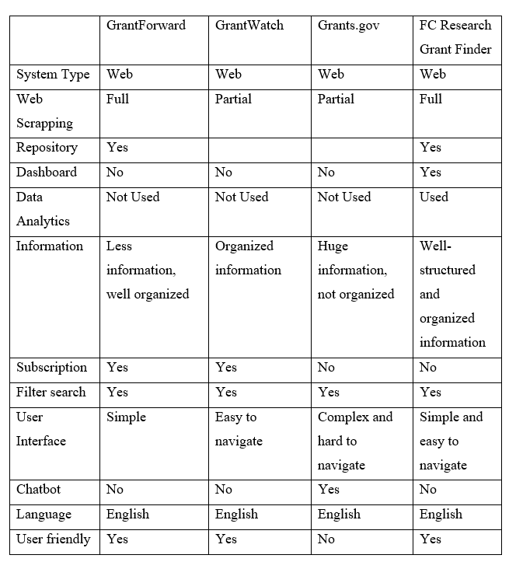
Current System Analysis

Slide 8
Technology Used
FrontEnd | Backend | Database
reactJS | Django | MongoDB

Slide 9
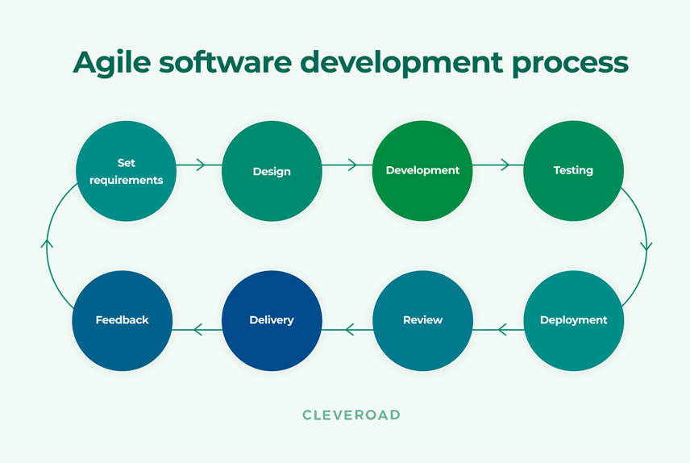
Methodology Used

Slide 10
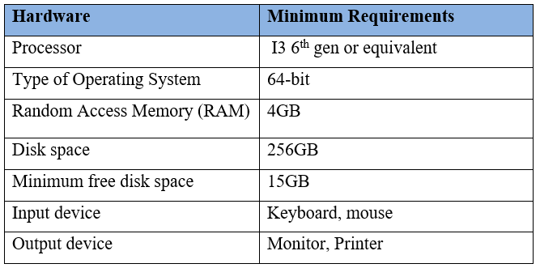
Hardware requirements

Slide 11
Software Requirements
Visual Studio Code
1.1.1.1 Enterprise architect
1.1.1.2 Windows 7/8/10 or equivalent MacOS
1.1.1.3 Google Chrome
1.1.1.4 Microsoft Word
1.1.1.5 Microsoft Excel

Slide 12
Requirement Analysis and Design

Slide 13
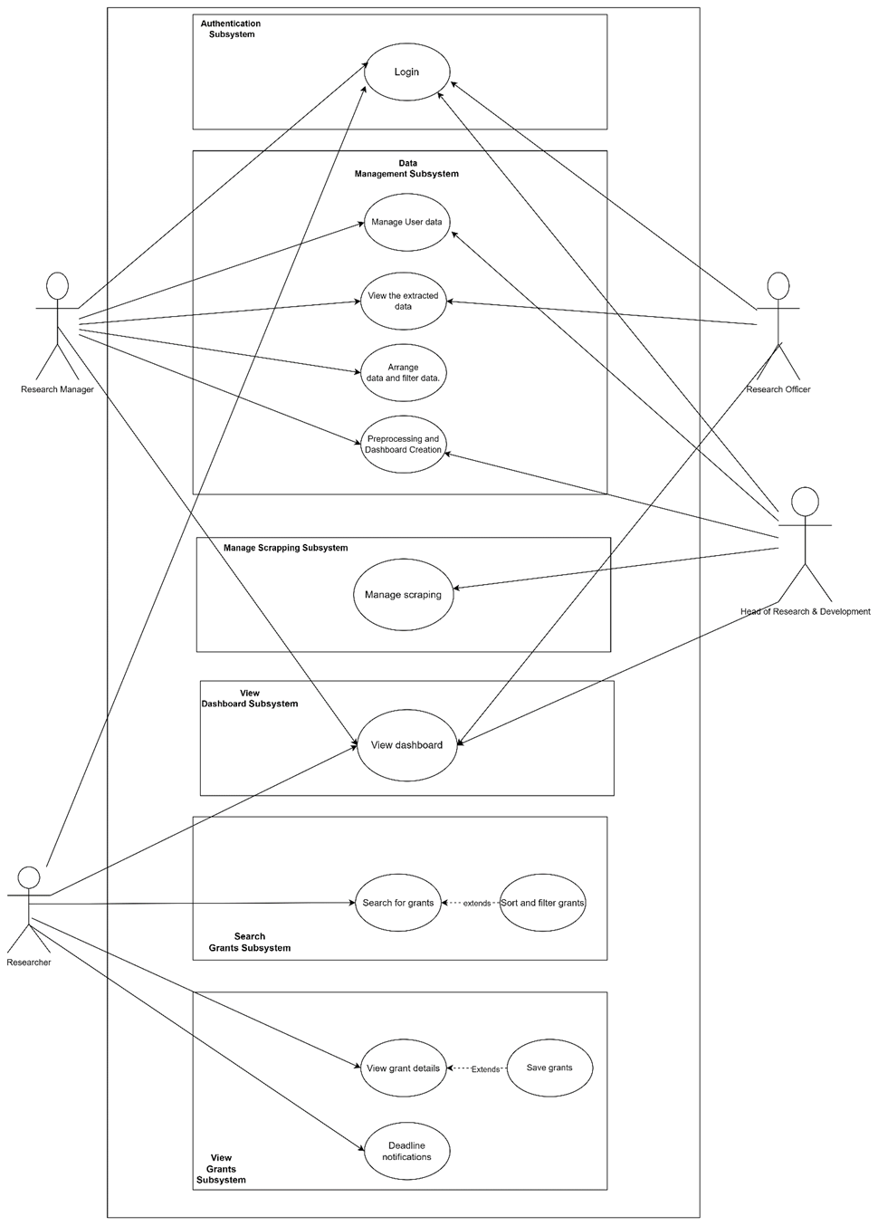
Use Case

Slide 14
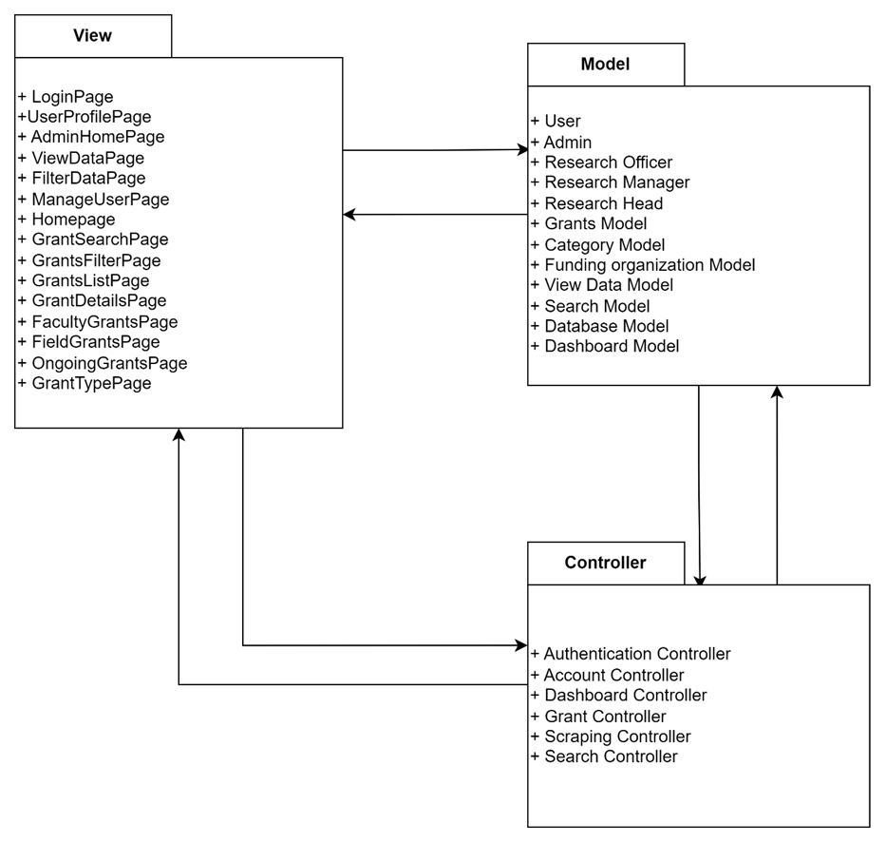
Spotlight on mobile
System Architecture

Slide 15
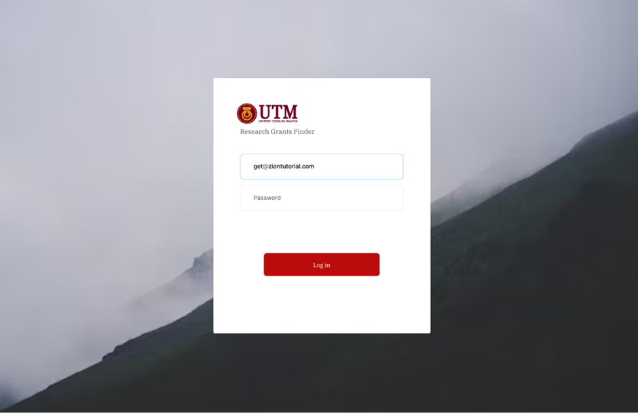
Spotlight on wearables
User Interface

Slide 16
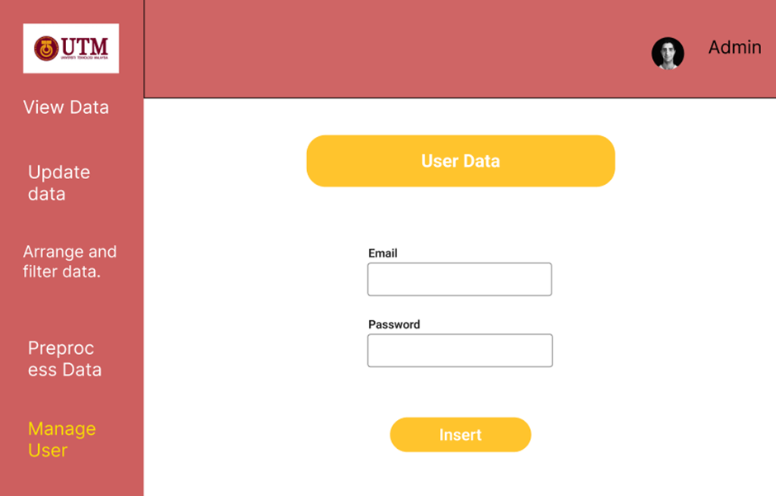
Spotlight on wearables
User Interface

Slide 17
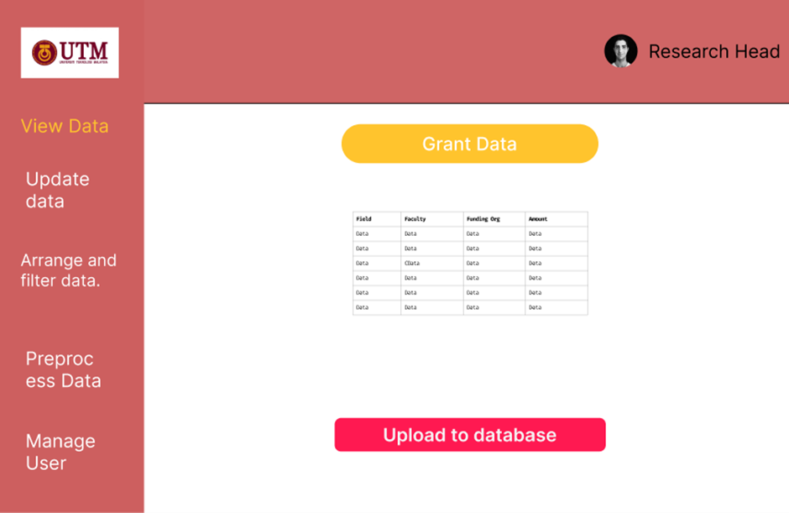
Spotlight on wearables
User Interface

Slide 18
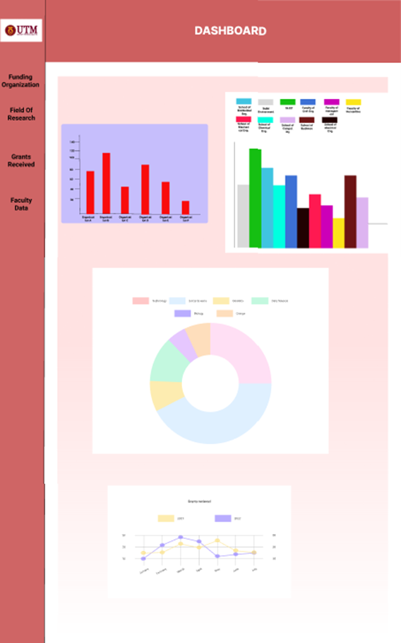
Spotlight on wearables
User Interface

Slide 19
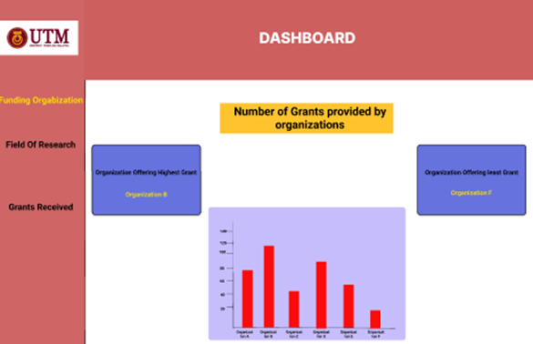
Spotlight on wearables
User Interface

Slide 20
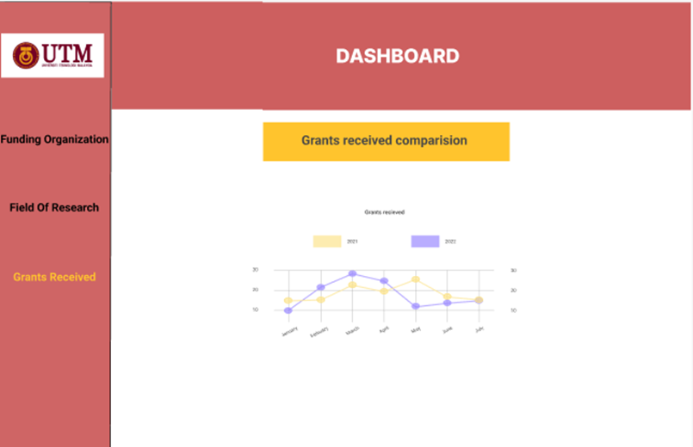
Spotlight on wearables
User Interface

Slide 21
Finally we can say that this system will be very beneficial to the researchers and it will speed up the research process of the university. The system will be available for future developments according to the requirements given by the stakeholders.
Conclusion:

Slide 22

Thank you! 😄

